Slide 1

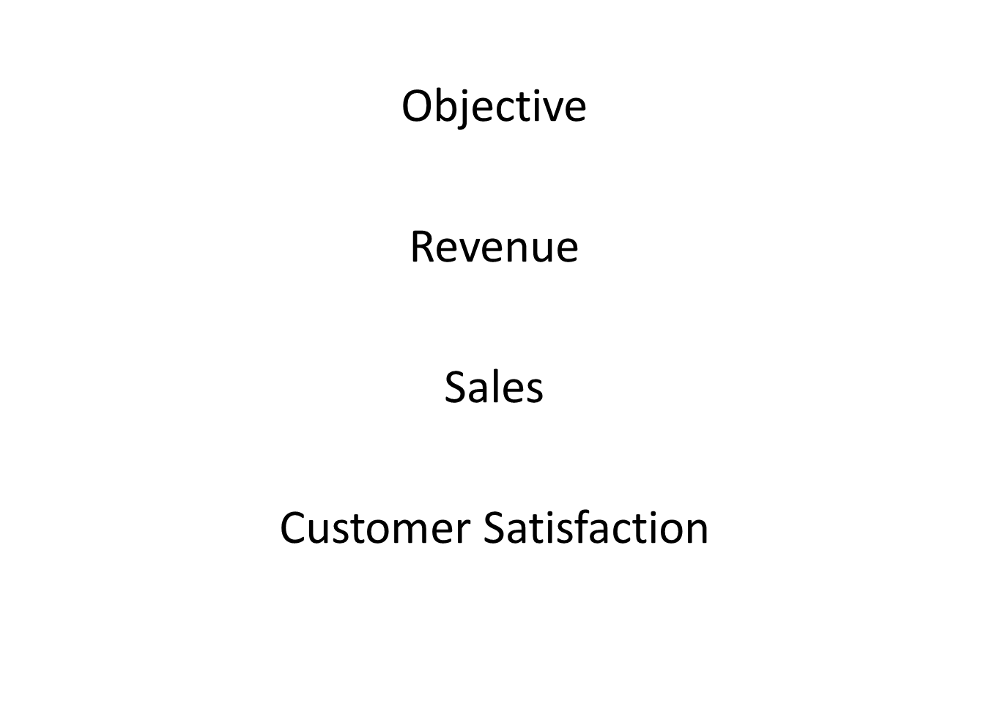


Slide 2
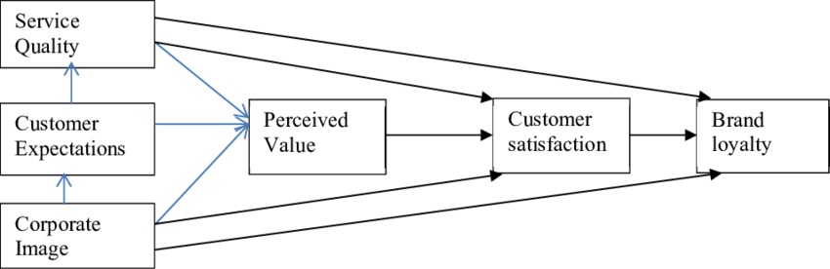

Slide 3
Airline Passenger Satisfaction
Team Details : Team mentor :
Akshat Shrivastava mr. Jatinder bedi
Pranshul Gupta
Yadvendra Singh Sengar
Tanay Dusad
Shagun Chauhan

Slide 4

Problem Statement :
Business problem-
Factor affecting Airline Passenger Satisfaction help to become the organisation either Star or Cash Cow .
Help to boost Revenue of the Organisation.
1. To propose changes in the airline’s UI.
2. To propose changes in services that are causing dissatisfactory behaviour towards airline services.

Slide 5


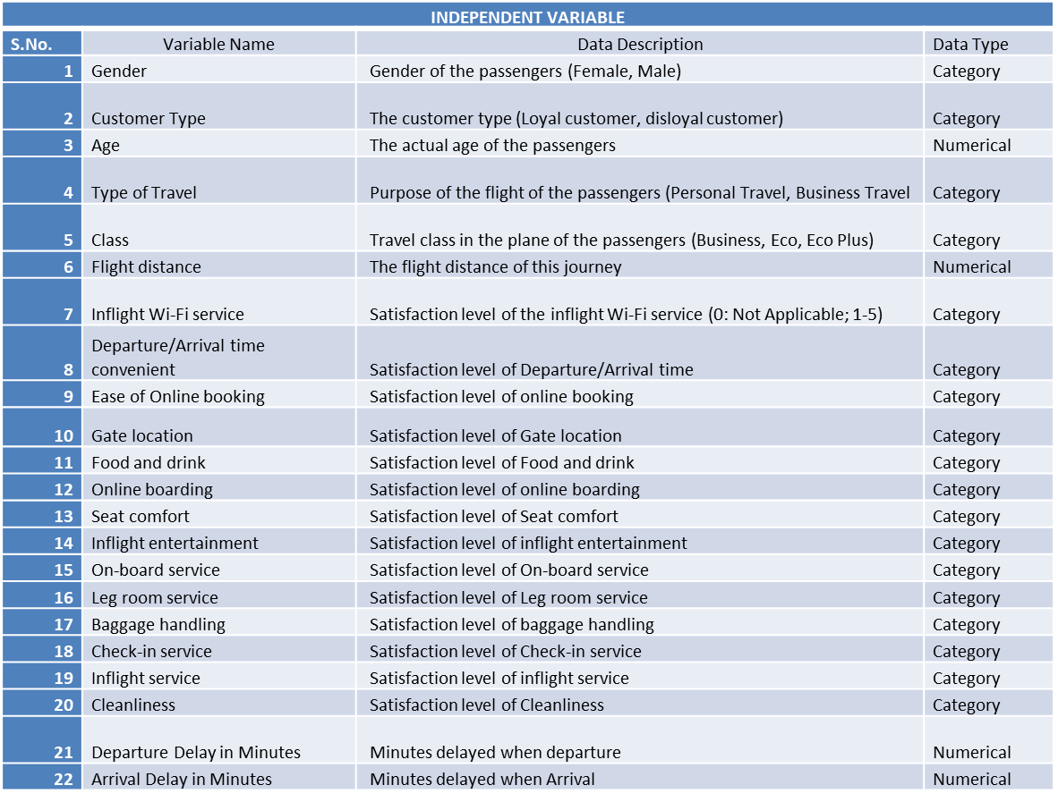
Data Summary
Rows/Columns :
Data Dictionary :

Slide 6
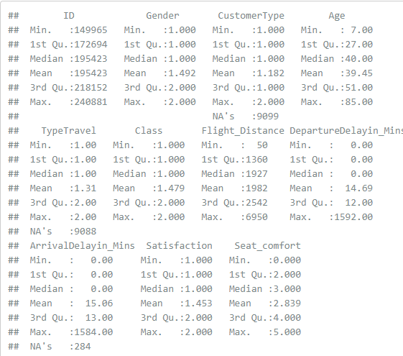
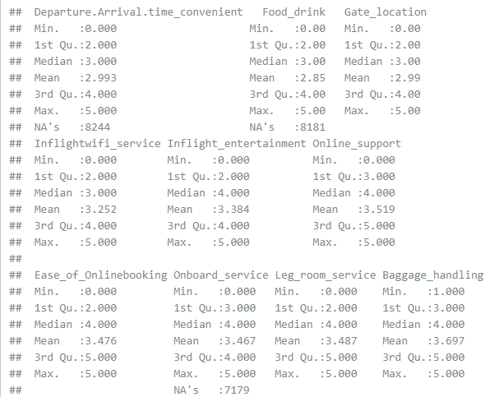
Five Points Summary :
Numerical :

Slide 7
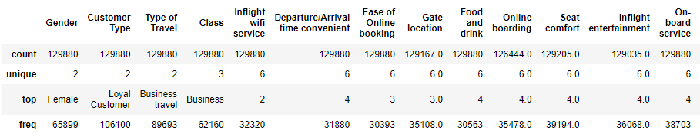
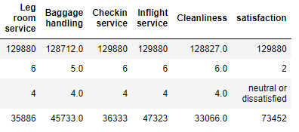
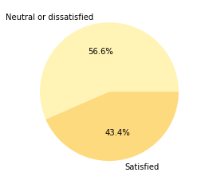
Five Points Summary :
Categorical :
Target Feature :

Slide 8
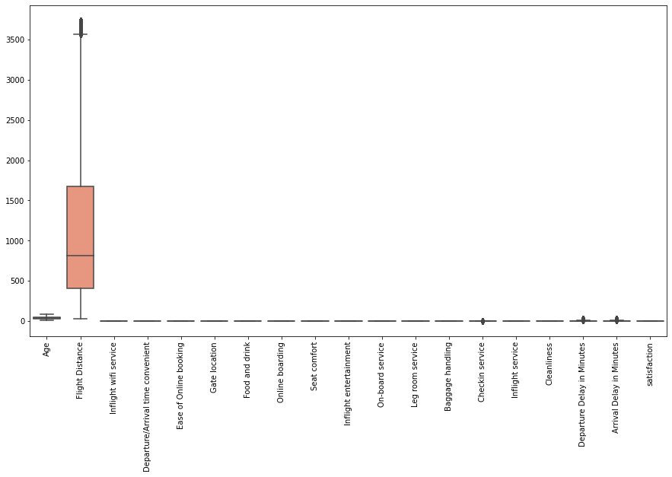
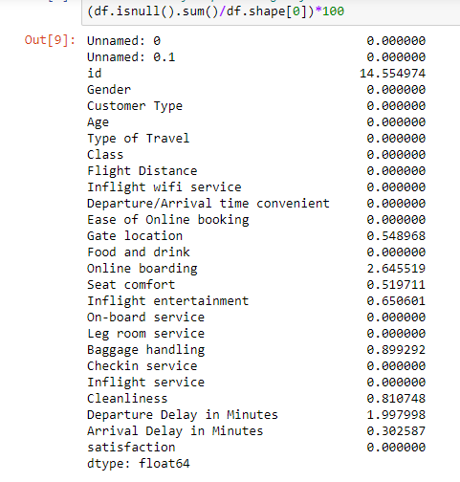
Null Values :
Preliminary Analysis
Inliers/Outliers :

Slide 9
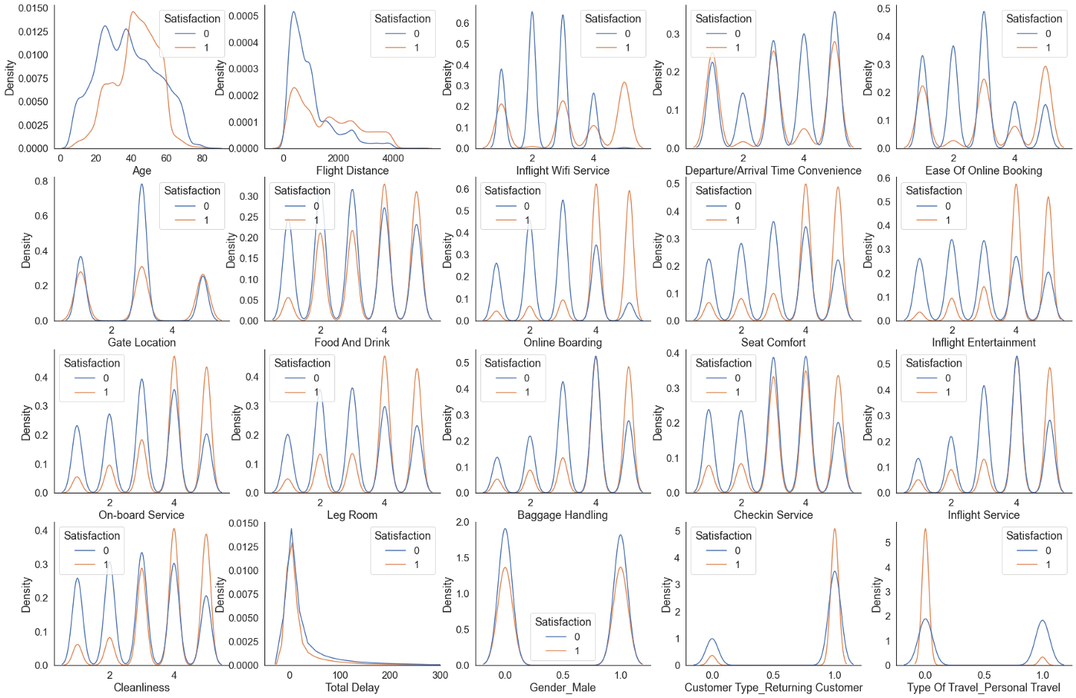
Uni-Variate Analysis :

Slide 10
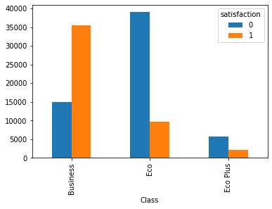
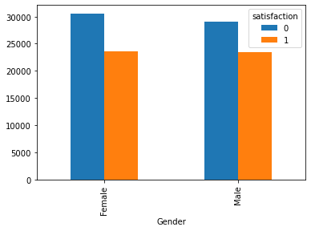
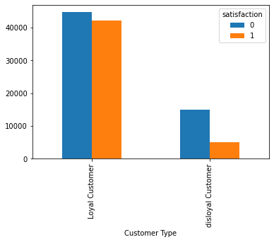
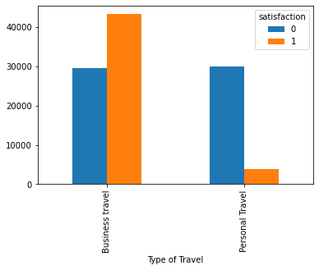
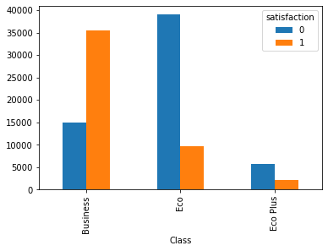
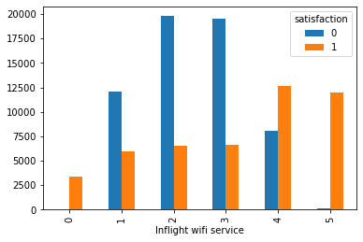
Bi-Variate Analysis

Slide 11
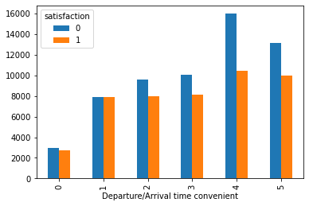
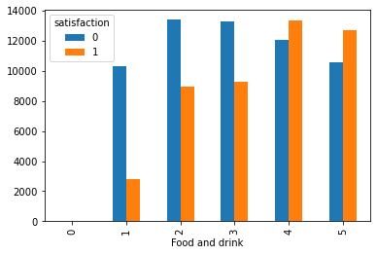
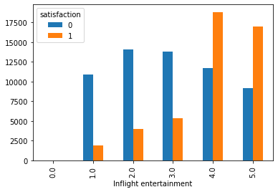
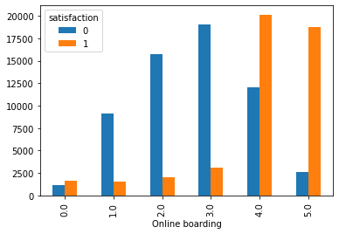
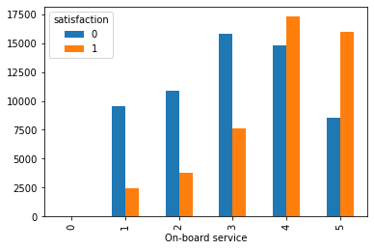
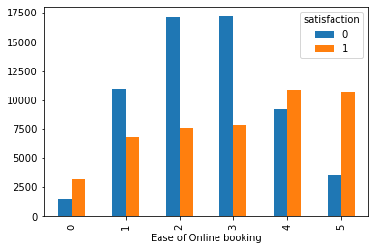
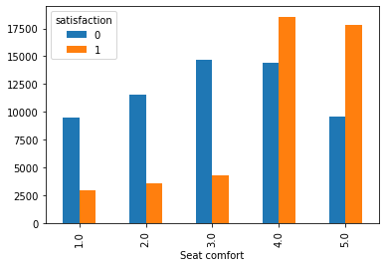
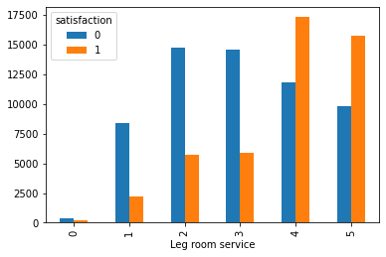
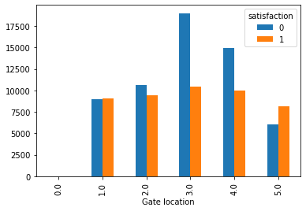

Slide 12
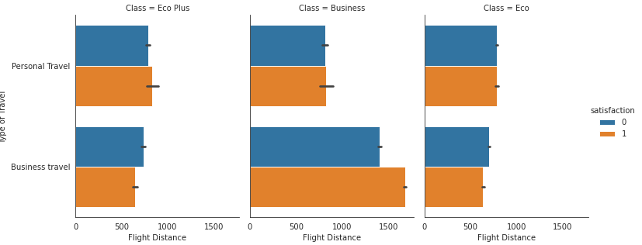
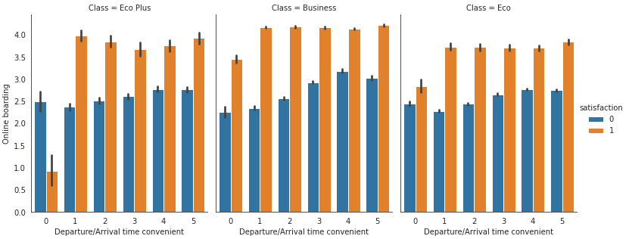
Multi-Variate Analysis

Slide 13
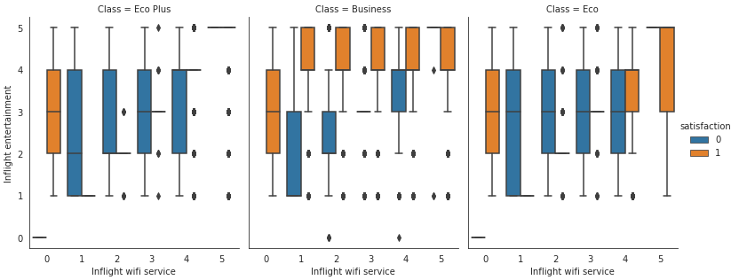
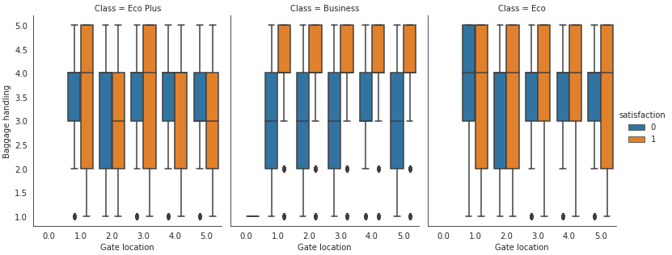

Slide 14
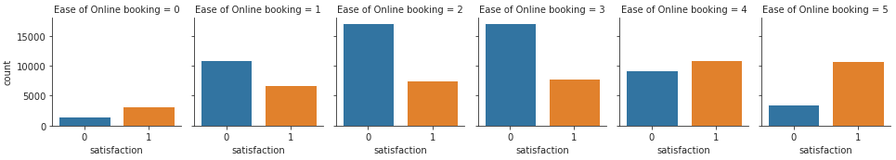
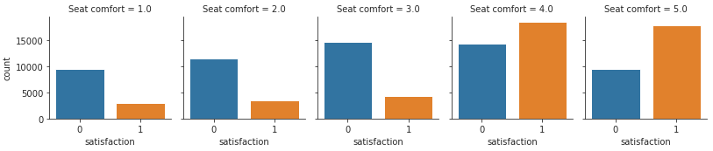
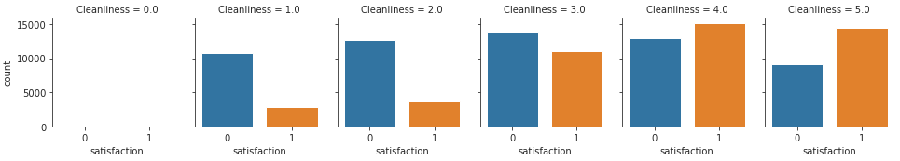

Slide 15
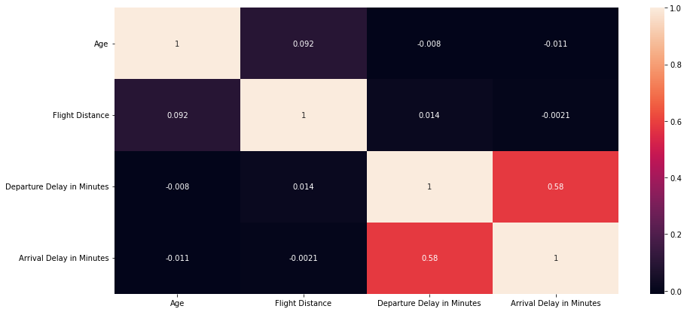
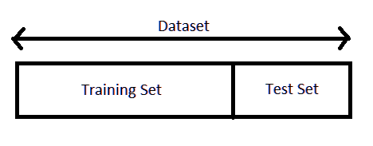
Correaltion of Features
Train – Test Split
70% 74724
30% 32025

Slide 16
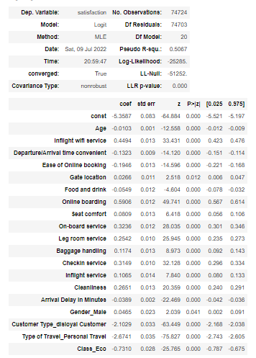
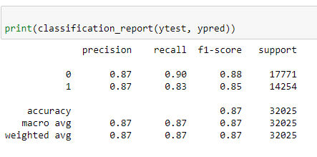
Logistic Regresion

Slide 17
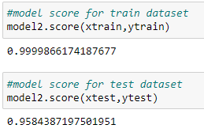
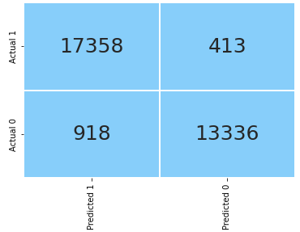
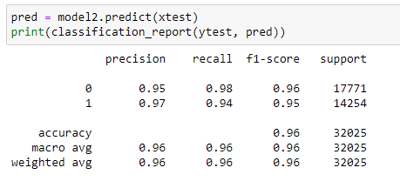
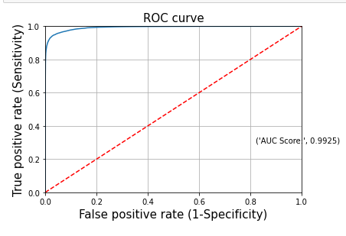
Extra-Tress Classifier

Slide 18
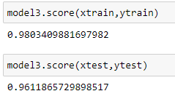
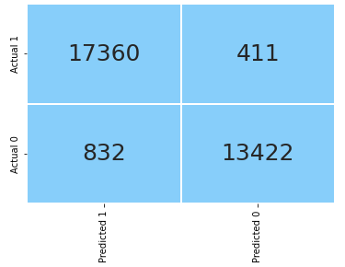
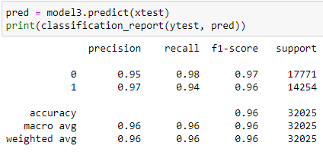
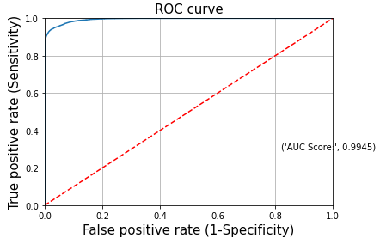
Gradient Boosting

Slide 19
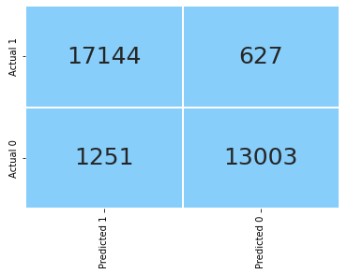
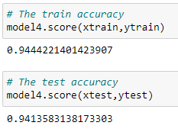
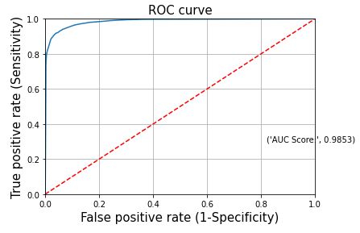
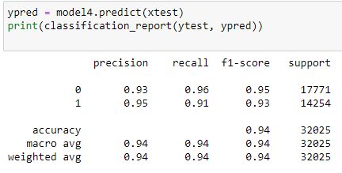
Decision Tree

Slide 20
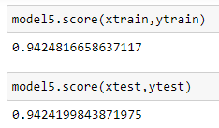



Random Forest

Slide 21

Model Evaluation

Slide 22
Conclusion
It is also revealed that out of 26 different features, 18 – 20 features are most important than the rest (45% - 81.8%). This also shows that Gradient Boost regularizes our final features (obtained through feature engineering) well and able to learn from the maximum features as possible.
If we compare our final model with the base model than following observations are observed on the test set:
Overall accuracy increased form 0.74 -> 0.96
Recall increased from 0.71 -> 0.95
Precision increased from 0.68 - > 0.98
F1 score increased form 0.70 -> 0.97
ROC – AUC score increased from 0.70 -> 0.99

Slide 23
THANK YOU

